Slide 1



Introduction of Transformer
Electronics & Communication Engineering Discipline
Jaypee Institute of Information Technology, Noida, U.P.

Slide 2
Cathode Ray Oscilloscope(CRO)
Introduction of Cathode Ray Oscilloscope
Construction of CRO
Working of CRO
Applications CRO
Jaypee Institute of Information Technology

Slide 3
Introduction of Cathode Ray Oscilloscope
The cathode-ray oscilloscope (CRO) is a multipurpose display instrument used for the observation, measurement , and analysis of waveforms by plotting amplitude along y-axis and time along x-axis
.
CRO is generally an x-y plotter; on a single screen it can display different signals applied to different channels. It can measure amplitude, frequencies and phase shift of various signals. Many physical quantities like temperature, pressure etc.
And also strain can be converted into electrical signals by the use of transducers, and the signals can be displayed on the CRO.
A moving luminous spot over the screen displays the signal. CROs are used to study waveforms, and other time-varying phenomena from very low to very high frequencies.
The central unit of the oscilloscope is the cathode-ray tube (CRT), and the remaining part of the CRO consists of the circuitry required to operate the cathode-ray tube.
Jaypee Institute of Information Technology

Slide 4
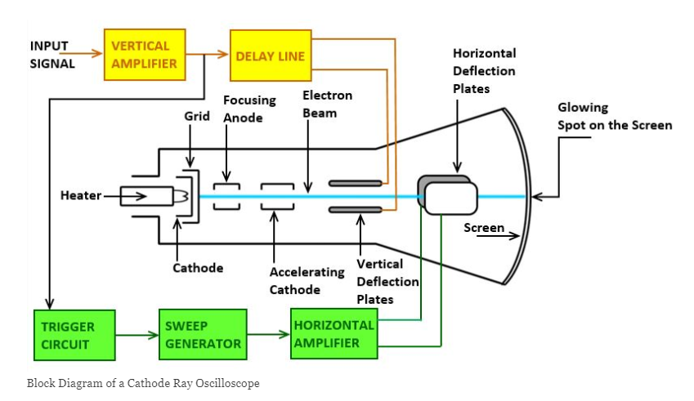
Block diagram of a cathode-ray oscilloscope
The cathode ray oscilloscope is an electronic test instrument, it is used to obtain waveforms at screen when the different input signals are given.
Jaypee Institute of Information Technology

Slide 5
COMPONENTS OF THE CATHODE-RAY OSCILLOSCOPE
The CRO consists of the following:
Input Signal
Vertical amplifier
Delay line
Triggering circuit
Time-base generator
Horizontal amplifier
Power supply
Cathode Ray Tube (CRT )
CRO outer part
CRO inner part
Jaypee Institute of Information Technology

Slide 6
COMPONENTS OF CATHODE-RAY TUBE
The Cathode Ray Tube (CRT) consists of the following parts:
Pin and Base
Heater
Cathode
Grid
Pre-acceleration anode
Focus anode
Accelerating anode
Aquad coating
Vertical deflection plat
Horizontal deflection plat
Phosphorus coated creen
Jaypee Institute of Information Technology

Slide 7
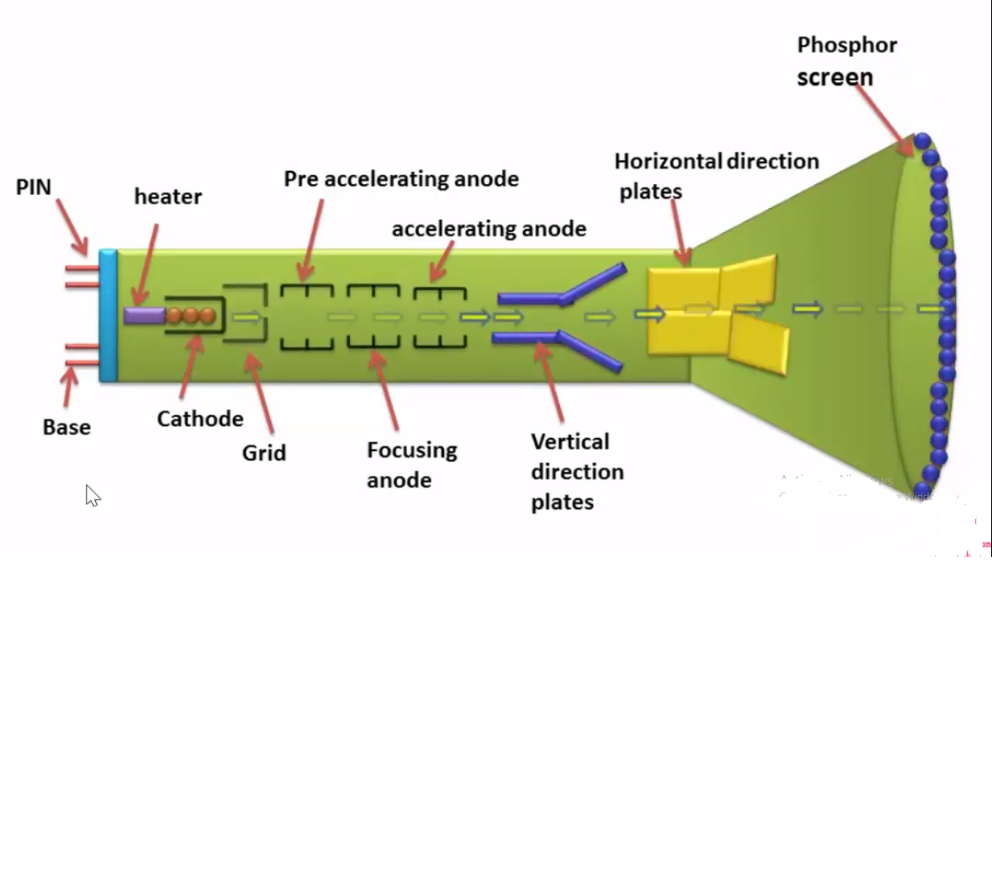
CATHODE-RAY TUBE
CRT is a device which converts electrical signal (Voltage, Current) into visual signal .
Heater produces heat by applying a voltage at base terminal through PIN
Cathode starts emits electron (e) when it gets heat up by heater.
Grid is used for focuses and passes a electron beam at high speed
Electron gun: Heater + Cathode + Grid+ Pre-Acc.+ Focusing An.+ Acc. Anode
Jaypee Institute of Information Technology

Slide 8
Pre-accelerating Anode: It is positive terminal of anode which attracts the electrons coming from the grid i.e. it provides a path for electrons beam to move on the screen side.
Accelerating Anode: It is also a positive terminal to provides path for electrons beam to move on the screen side.
Vertical deflection Plate: It is used to provide a direction of electrons at the screen side on y axis i.e. up and down direction on the screen.
Horizontal deflection plate: It is used to provide a direction of electrons at the screen side along the x axis i.e. left and right direction on the screen.
Aquad coating: In that case, if electrons comes out of their path then it repels and helps electron to come again focusing path.
Phosphors screen: This screen is a coated with phosphorus. As electron strikes on the phosphorus screen it produes a light which appear on the screen.
Jaypee Institute of Information Technology

Slide 9
Power Supply
It provides the voltages required by the cathode ray tube to generate and accelerate the electron beam.
Cathode ray tube (CRT) requires high voltage for pre-accelerating and accelerating anode, low voltage required for heater, control grid, focusing anode and the other circuits of CRO.
Vertical Amplifier
Vertical means that along y axis (Up and down) while amplifier means increase the strength of weak signal. It is used to amplify the weak signal so that the amplified signal can produce the desired signal.
The signal under the analysis is to be applied to vertical deflection plates through the vertical amplifier.
Jaypee Institute of Information Technology

Slide 10
Delay line
Delay line is used to hold the vertical signal at vertical deflection plate.
If both vertical and horizontal signals arrives at the same time to the corresponding deflection plates, then only we will get exact waveform.
But vertical signal arrives much early compared to the horizontal signal. For this reason, the vertical signal at the output of the vertical amplifier should be delayed with the help of delay line. The delay time is almost equal to 200nsec.
Trigger circuit
It is link between the signal wave form to be observed (vertical input) and time-base (horizontal input)
This is triggered by the portion of the vertical amplifier output.
This circuit initiates then time base generator. It is the link between the vertical input and horizontal time base.
Trigger circuit is used synchronization between horizontal deflection and vertical deflection.
Jaypee Institute of Information Technology

Slide 11
Time-base generator
Generate the saw tooth wave form (Ramp voltage)
It also control the electron beam at the sceen.
Horizontal Amplifier
The saw tooth voltage produced by the time base generator may not be of sufficient strength.
Hence before giving it to the horizontal deflection plates, it is amplified using the horizontal amplifier.
Jaypee Institute of Information Technology

Slide 12
Applications of CRO
CRO is used to display, measure and analyze various types of wave form and other phenomena in electrical and electronics circuits such as
Examination of Waveform
Frequency measurement
Phase measurement
Voltage measurement
Current measurement
Jaypee Institute of Information Technology

Slide 13
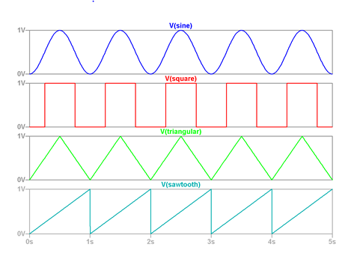
Function Generator
A function generator is a signal source that has the capability of producing different types of waveforms as its output signal.
The most common output waveforms are
sine-waves
Square Wave
Triangular waves
Sawtoot waves
The frequencies of such waveforms may be adjusted from a fraction of a hertz to several hundred kHz.
Actually, the function generators are very versatile instruments as they are capable of producing a wide variety of waveforms and frequencies.
Jaypee Institute of Information Technology

Slide 14



Function Generator Working
Schmitt Trigger
Integrator
Attenuator
Sin wave converter
Integrator: convert square wave into triangular wave
Schmitt trigger: Convert any wave into square wave
Sin wave converter: Convert any wave into sinusoidal wave
Attenuator: Reduce the amplitude of the signal
Jaypee Institute of Information Technology

